Slide 1


AWS Mini Project
Yashwanth Naidu

Slide 2
Overview
IAM Hands-on
Billing Alarm
S3 Bucket
EC2 Instance
Security Groups
Volumes and Snapshots
AMI
Laod Balancer
Auto Scaling Group and Launch Template
RDS (Relational Database)

Slide 3

Lab 1 - IAM Hands-on
Set up MFA for the root user.
Create a new user with EC2 permissions.
We Can’t work with any other services except ec2.
Provide Administrator access and explore various services.
Remaining services also work with the Admin permissions.

Slide 4

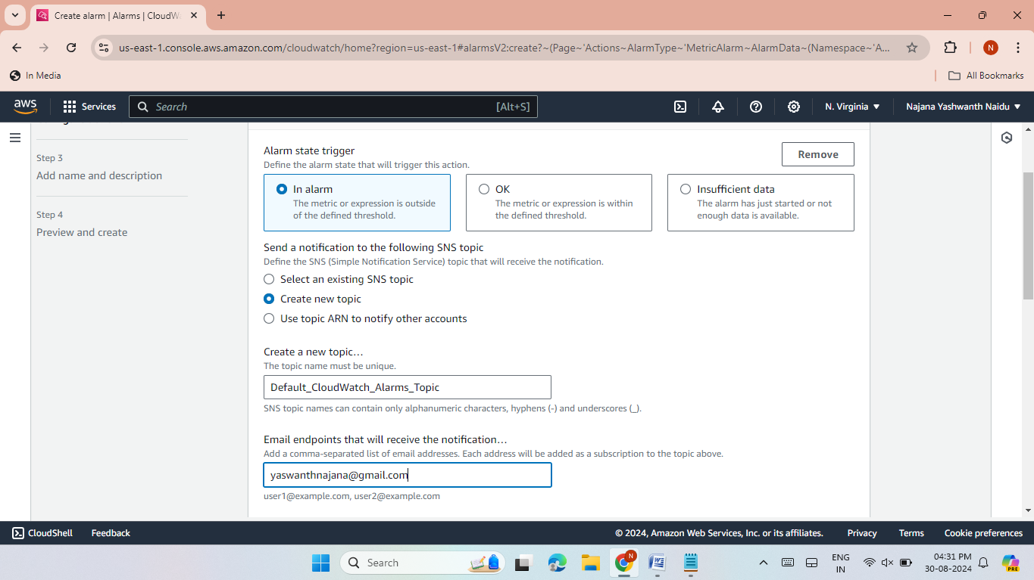
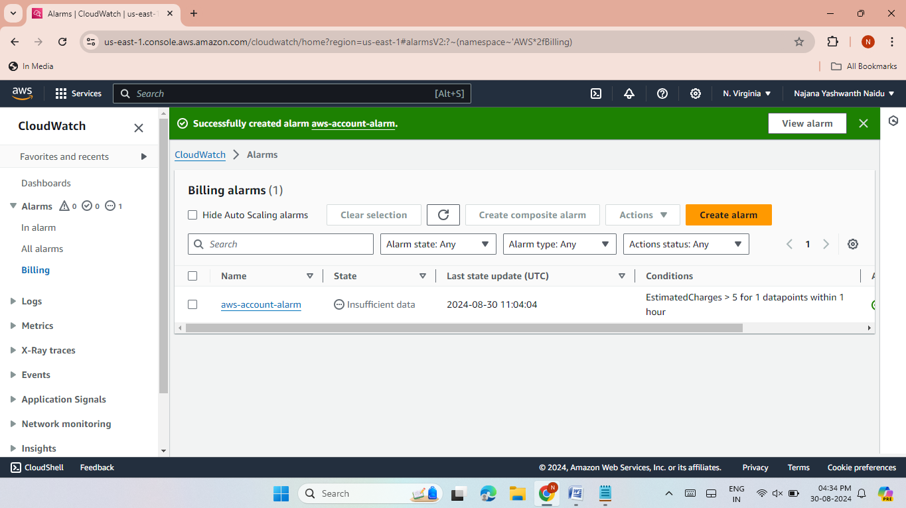
Lab 2 - Billing Alarm
1.
Setup a billing alarm using SNS for email notifications.
Setup a billing alarm using SNS for email notifications.
Enter the email for receiving the notifications.
Enter the name of Alarm.
Successful alarm creation.
2.
Together, the project's vision and mission form the foundation
Successful alarm creation.

Slide 5

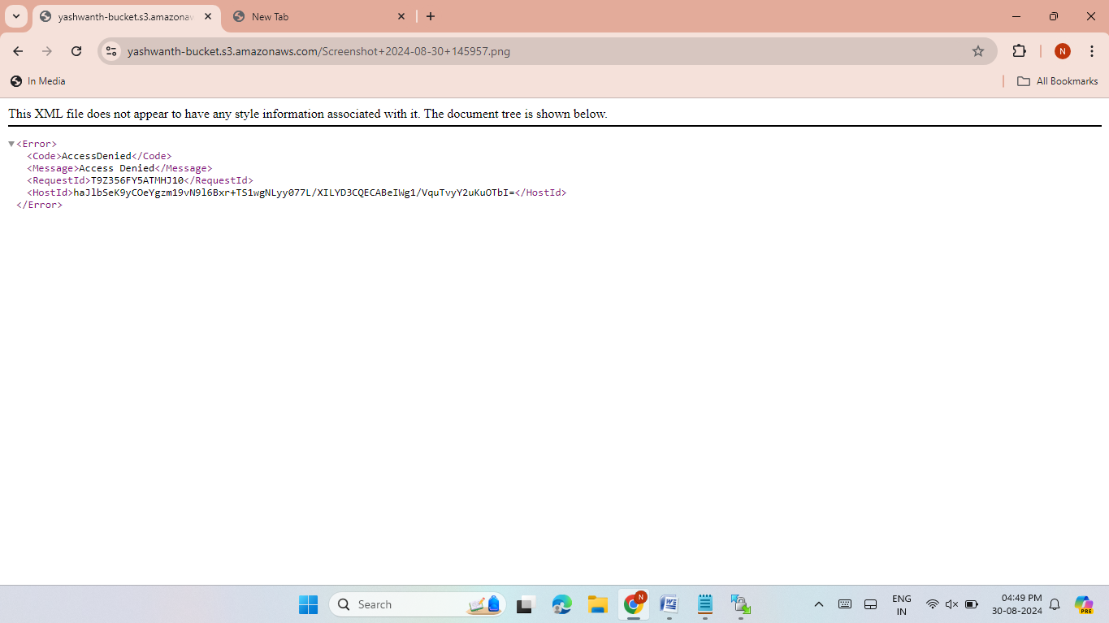
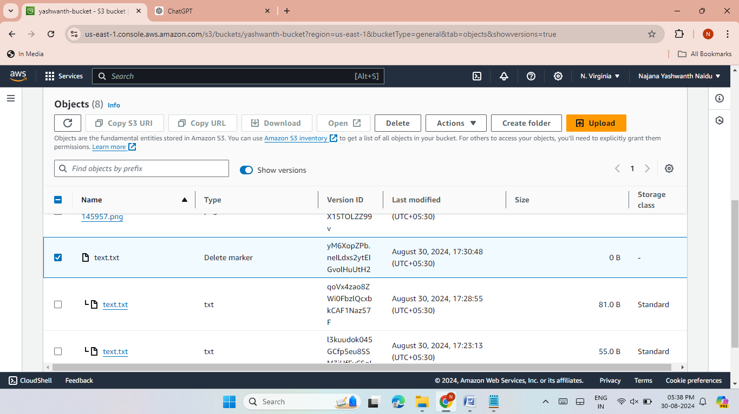
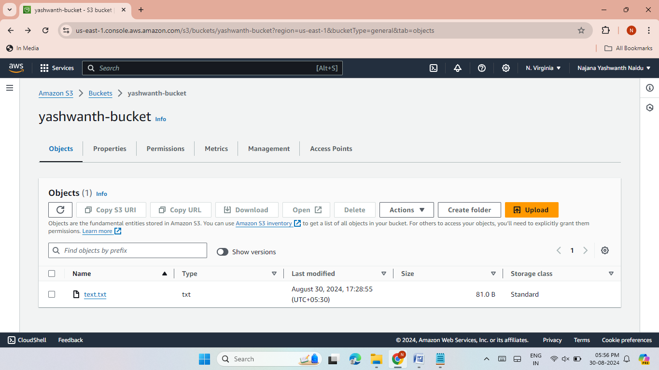
Lab-3: S3 Bucket Operations
Create an S3 bucket and upload files.
Grant public access and access files via the URL.
Enable versioning and restore deleted files.
Now browse the URL it will display the content of the deleted file.

Slide 6
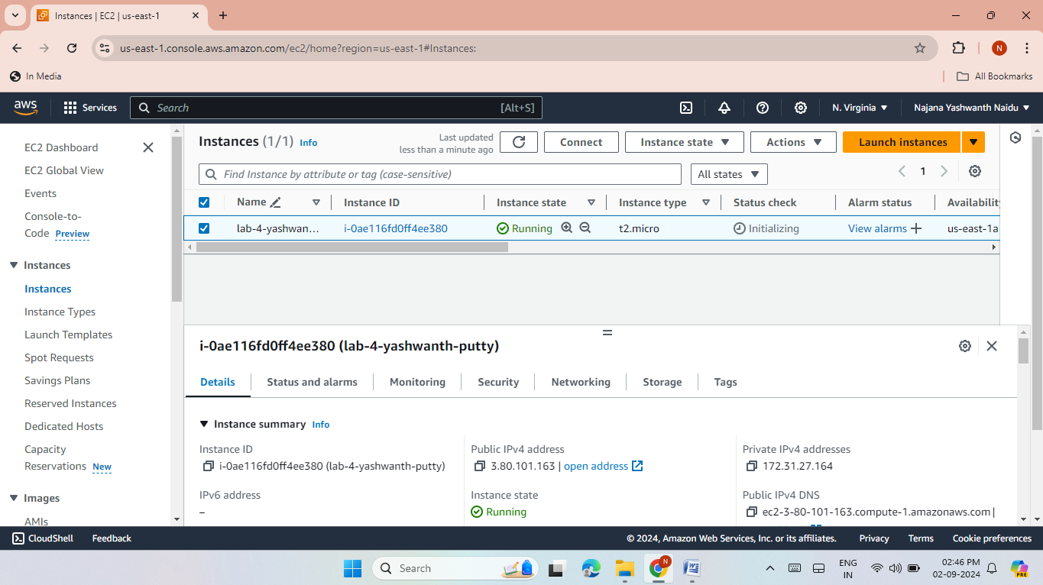
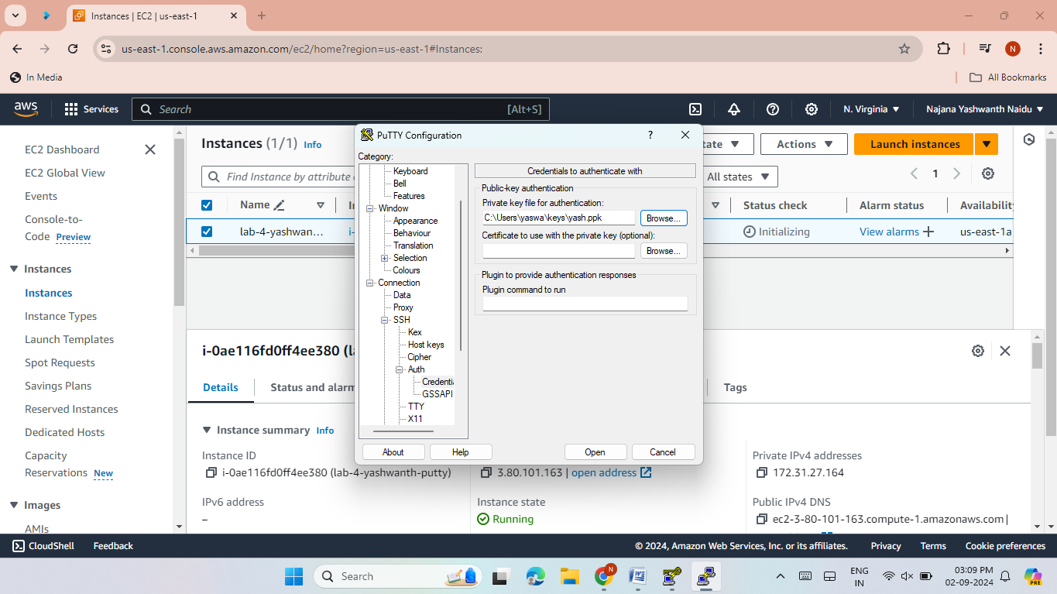
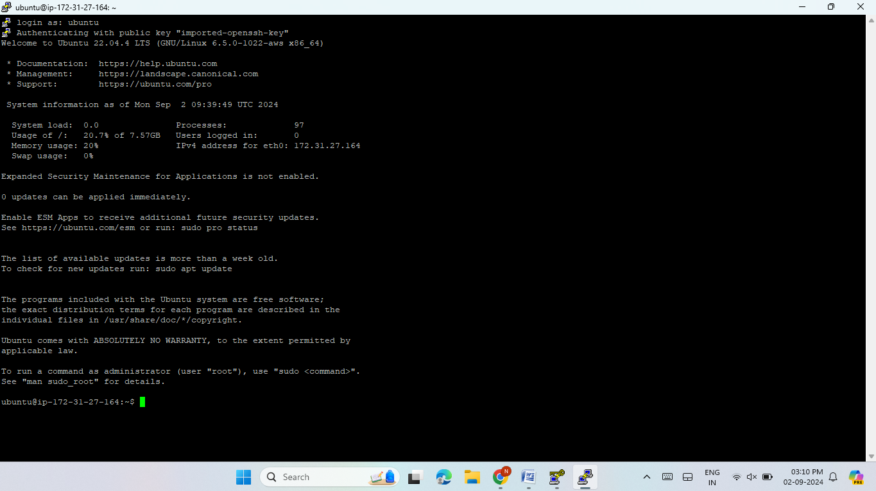

Lab 4 - EC2 Instance
1
2
3
Launch an Ubuntu t2.micro instance.
Access it via SSH using Putty.
Now I have access instance using PPK file in putty software.

Slide 7
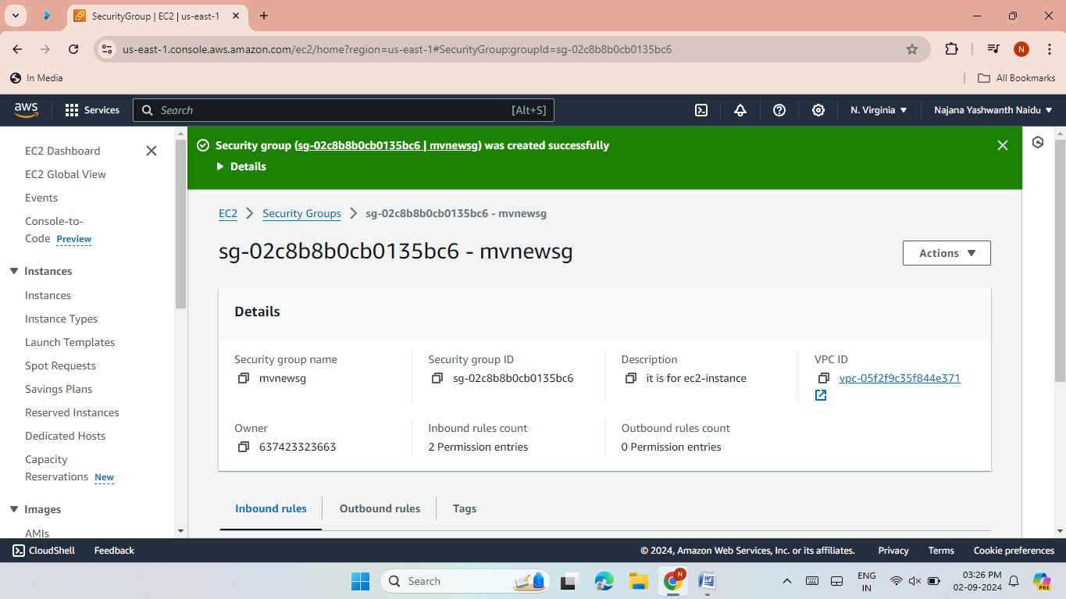
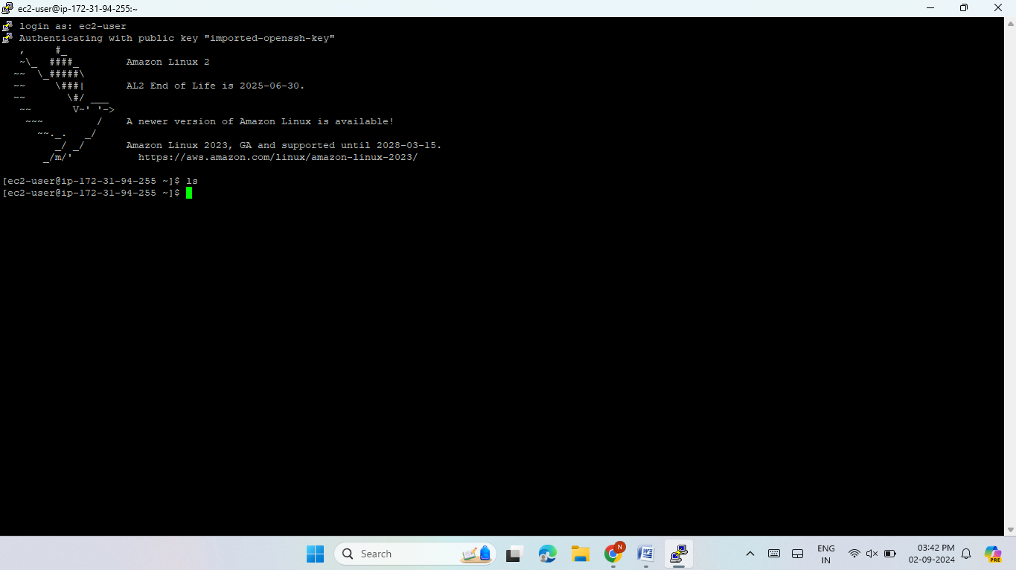
Lab 5 - Security Groups
Create and attach a security group allowing HTTP/SSH access.
Successfully access the EC2 instance.

Slide 8
Lab 6 - Volumes and Snapshots
Create and attach a 5GB volume to EC2.
Put some data in this volume.
Check if the volume is attached OR not.
Using lsblk, mkdir /mnt/myvolume.
Create a some text files In myvolume directoery.
Expand the volume to 8GB.
Check the size in EC2 instance using the command lsblk.
Extend the size of this of this volume inside the Linux machine.
sudo resize2fs /dev/xvdf.
Create a new volume with the snapshot and attach it to the server.

Slide 9
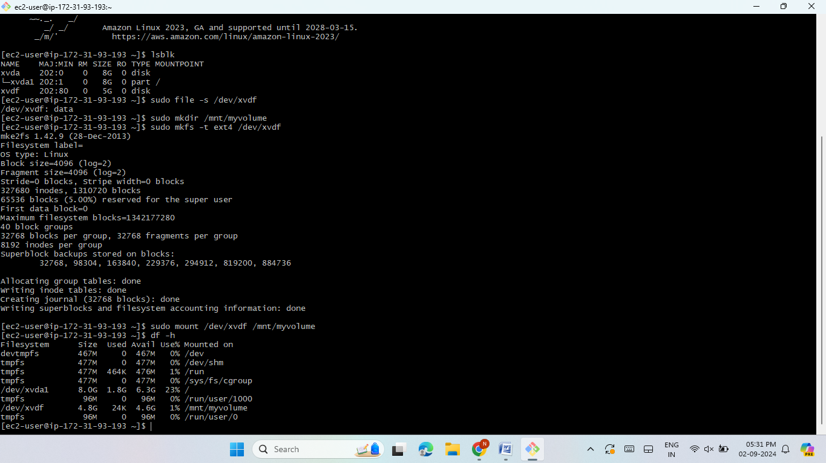
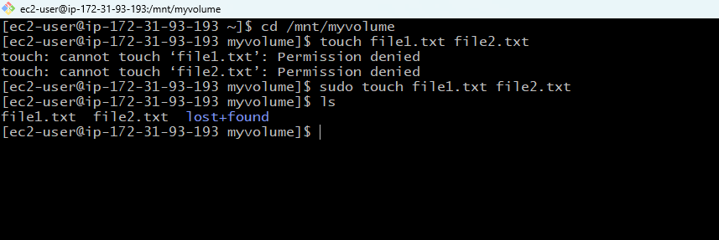
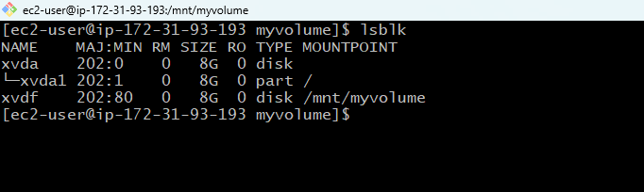
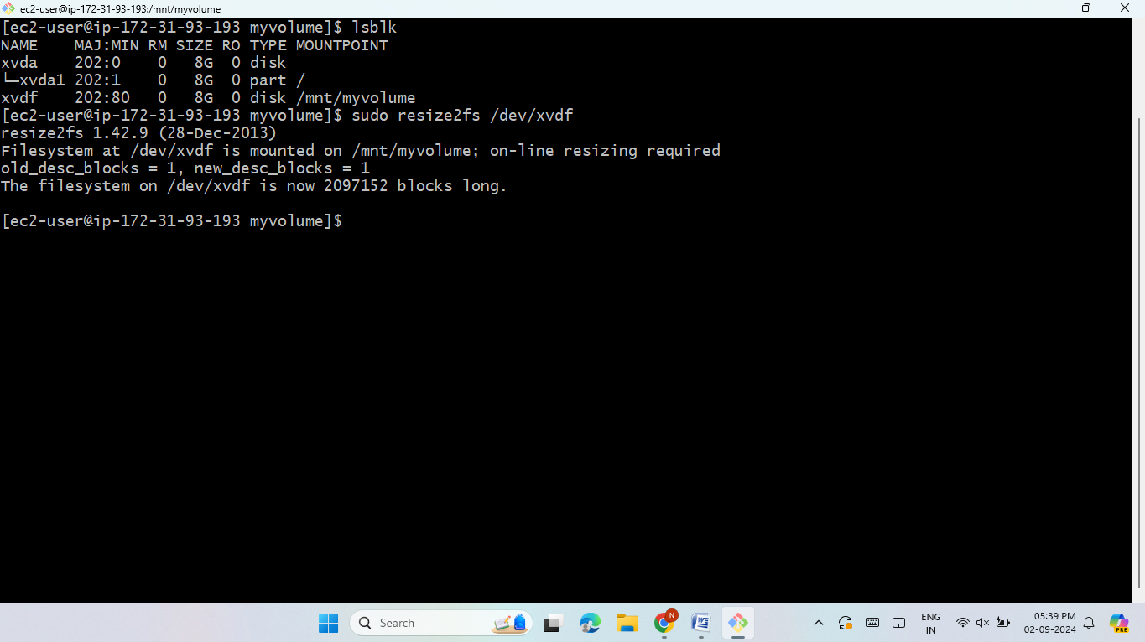
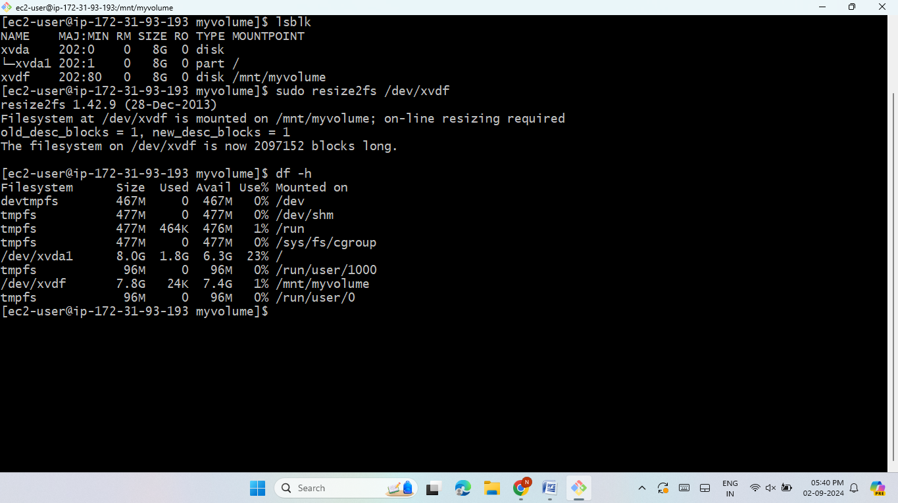

Slide 10

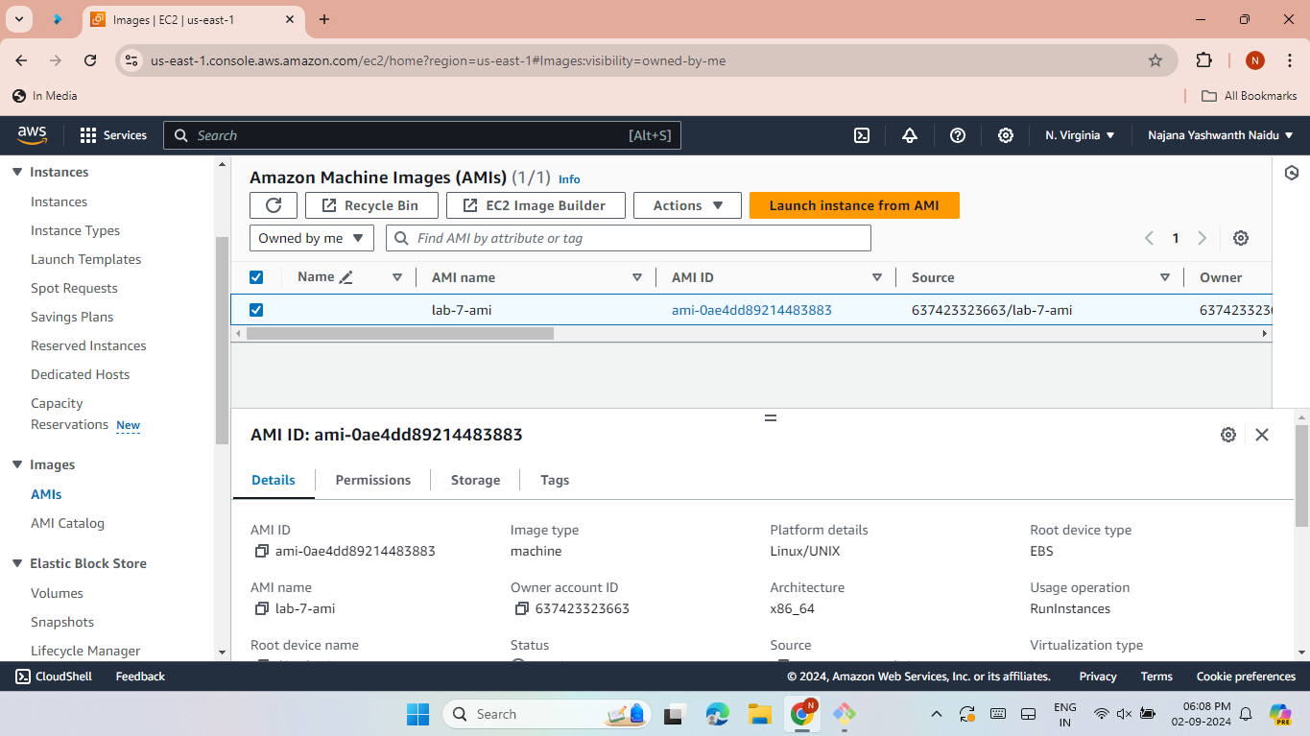
Lab 7 - AMI Creation
Create an AMI from a running EC2 instance.
Attach the AMI to the existing instance.

Slide 11
Lab 8- Load Balancers
Launch two EC2 instances with NGINX and Apache servers.
Access both the servers over browser and check the web page.
Create and configure a load balancer.
Create a target group and attach to the load balancer.
Register the instances in the target group.
Access web pages using the load balancer DNS.

Slide 12
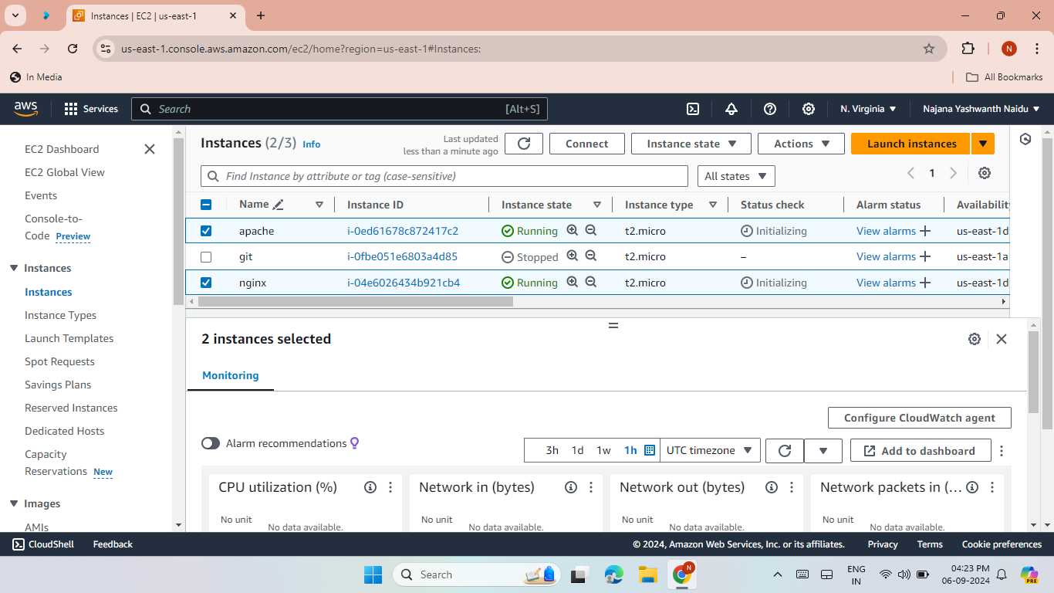
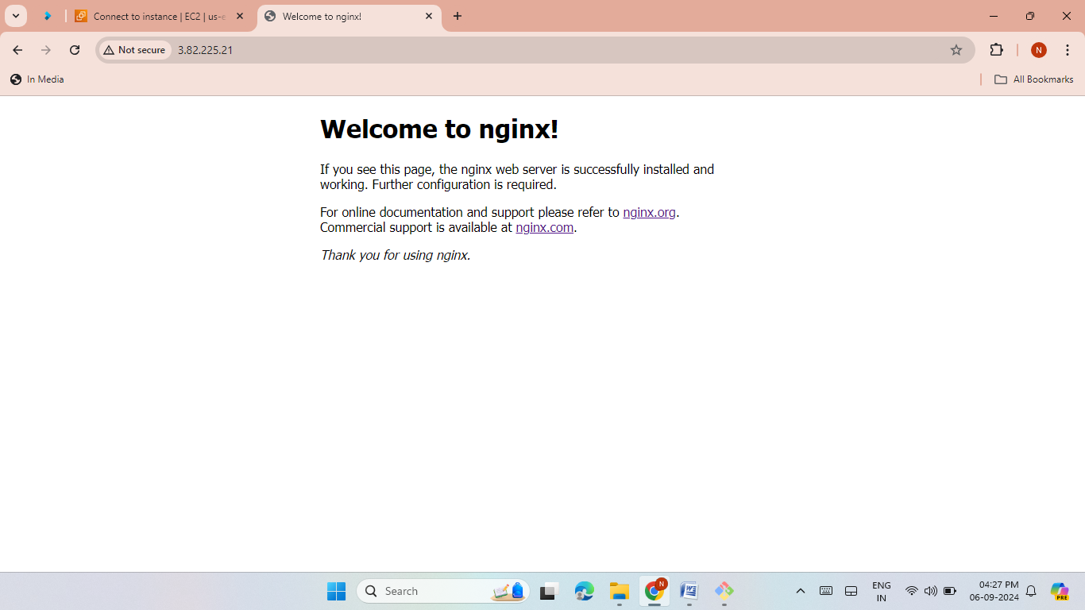
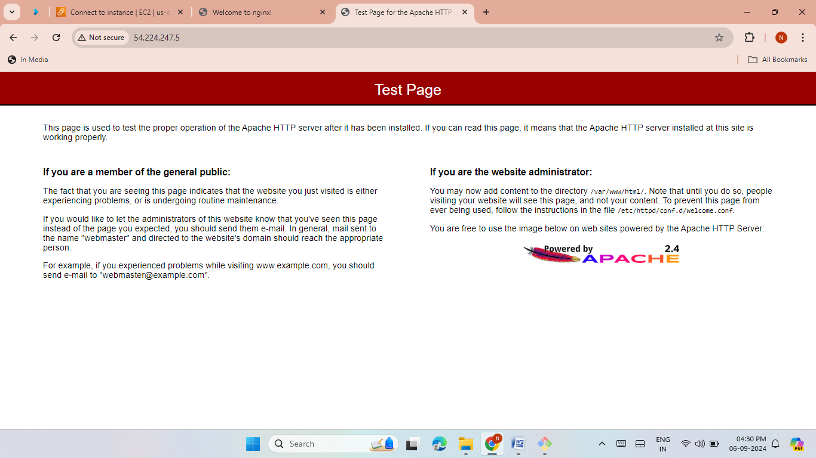
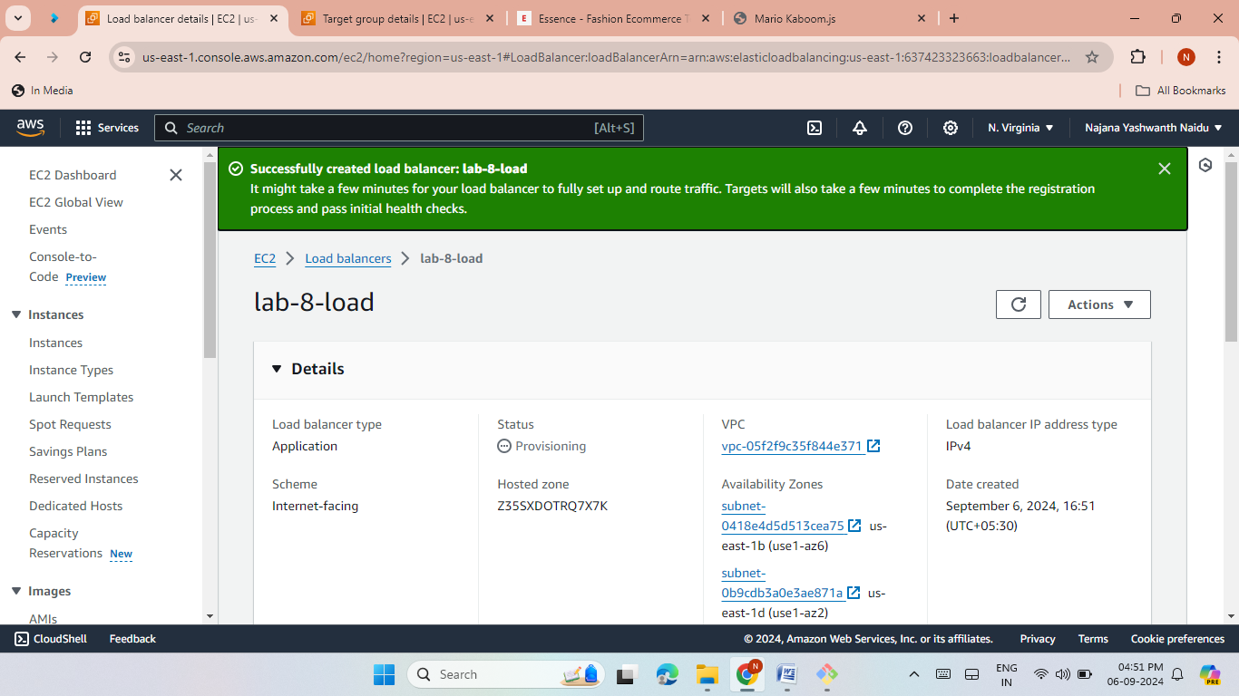
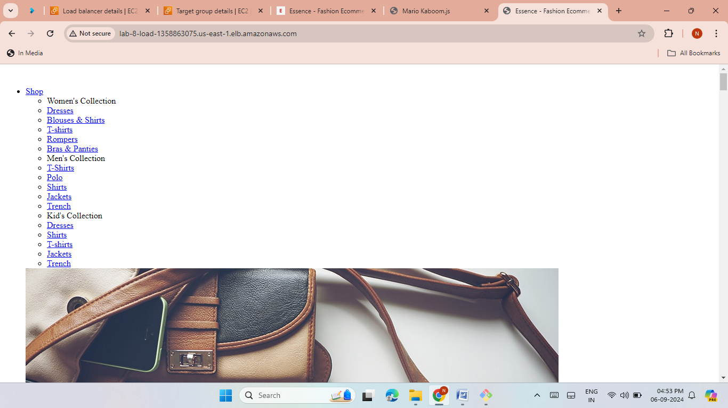
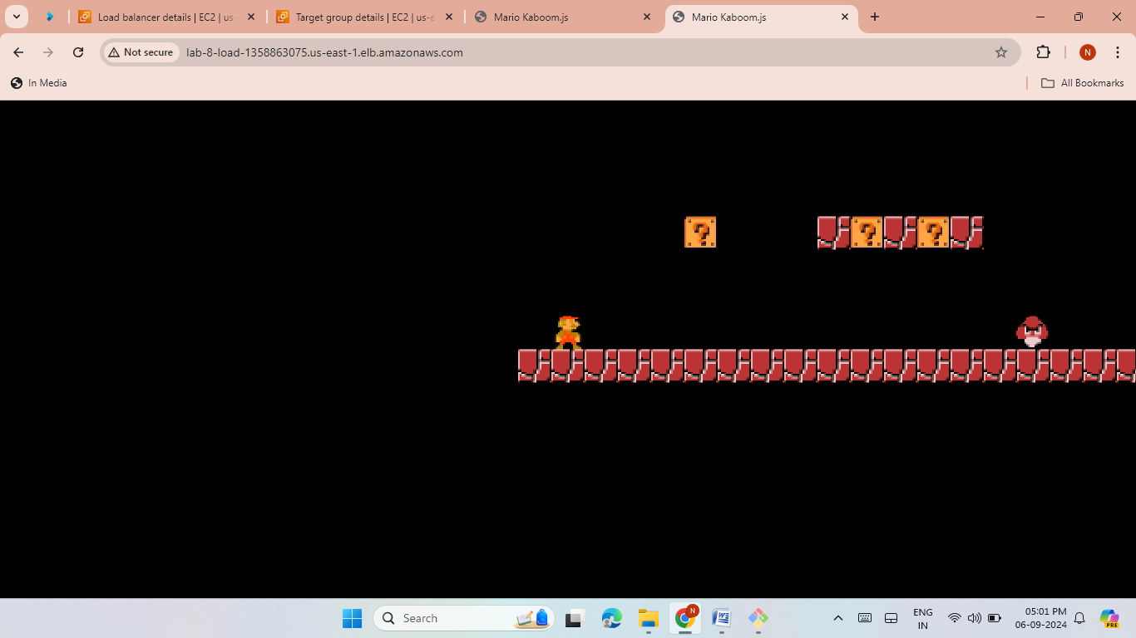

Slide 13

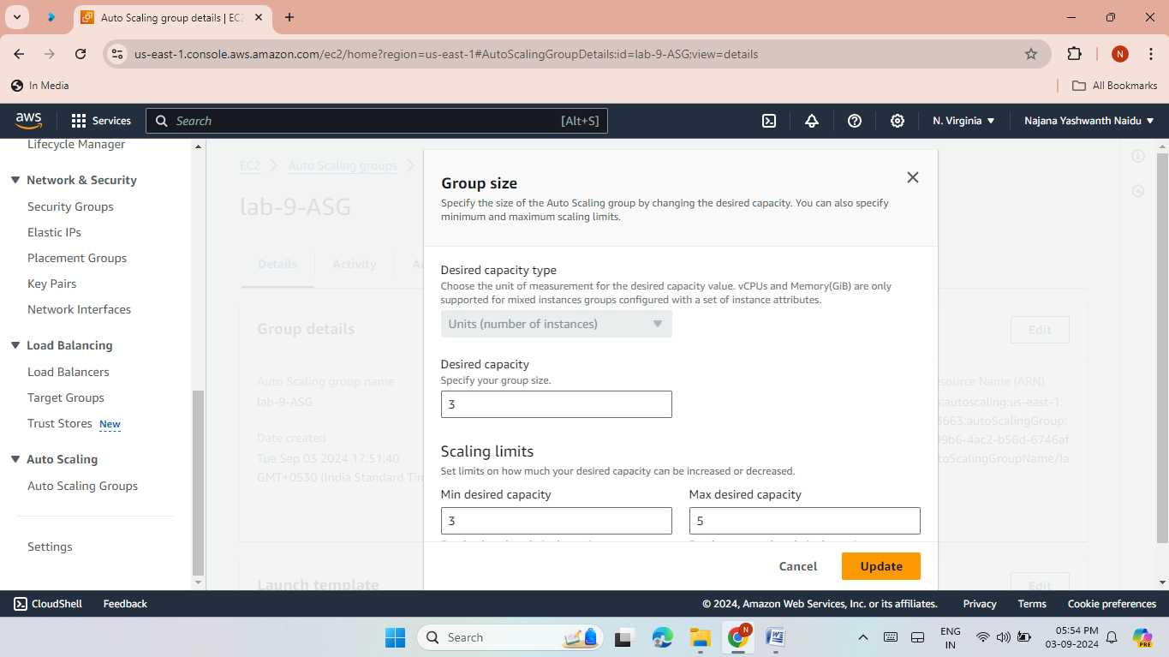
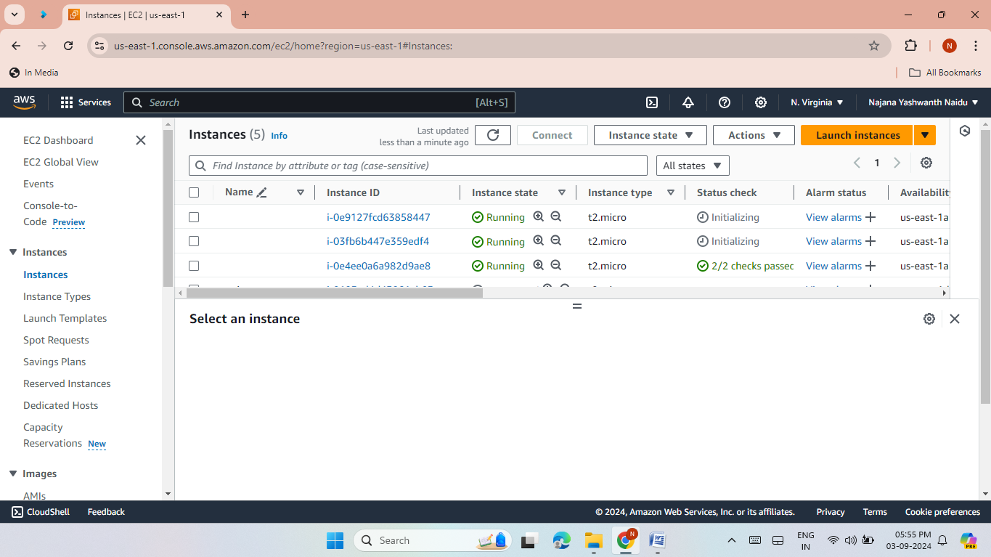
LAB 9: AUTO SCALING GROUP AND LAUNCH TEMPLATE
Create a launch template and auto-scaling group.
Size min 1 and max 3
Increase the size.
Test scaling by increasing instance limits.

Slide 14
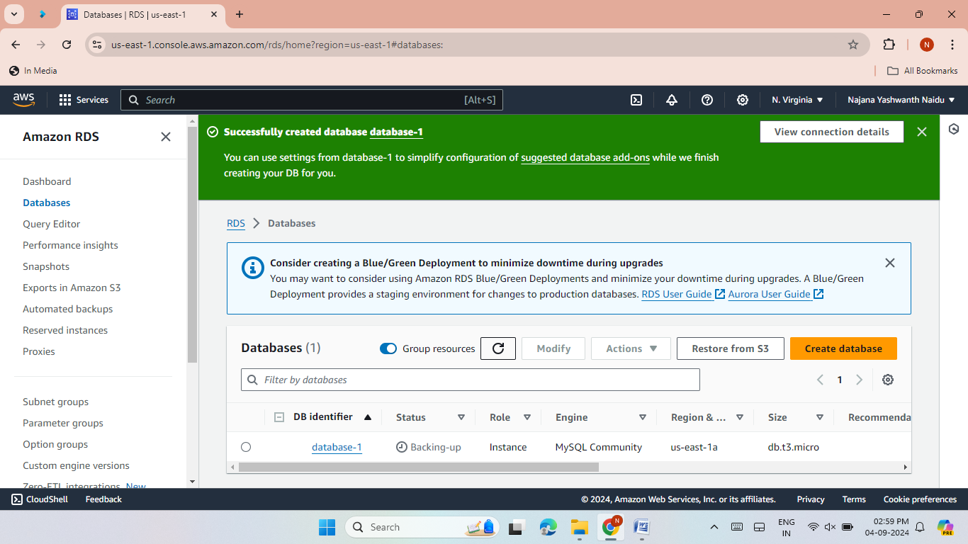
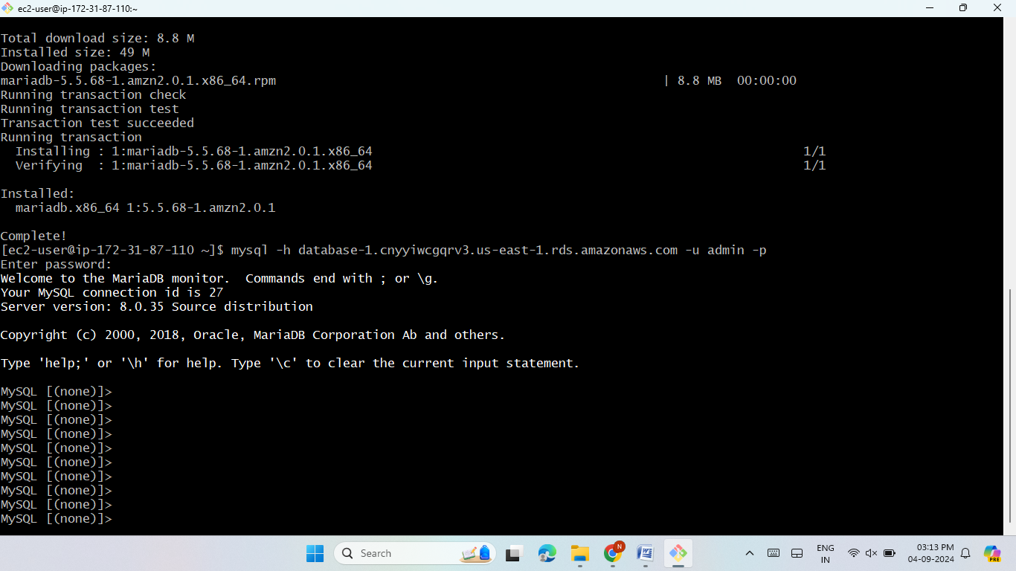
Lab 10- RDS (Relational Database)
Create an RDS instance with MySQL.
Access the RDS from an EC2 instance.

Slide 15

THANK YOU!

